Slide 1
Computer Algorithms

Slide 2
Fact: computers are dumb machines
Basic property of a computer (a machine):
Computers do what we tell them to do
Unfortunately, computer do not necessarily do what we want them to do....
(Because we can make mistake in telling the computer what we want to do... These mistakes are called "bugs")
GLA UNIVERSITY

Slide 3
Algorithm
Definition: algorithm
Dictionary definition:
Algorithm = a step-by-step procedure for solving a problem or accomplishing some task, especially by means of a computer
GLA UNIVERSITY

Slide 4
Computer Algorithms
Computer Algorithm:
is an algorithm that can be executed by a computer
GLA UNIVERSITY

Slide 5
Computer Algorithms (cont.)
Properties of computer algorithms:
The steps in an algorithm must be consists of operations that can be executed by a computer
The step in an algorithm must be unambiguous
(Remember that a dumb machine like a computer will do what it is told to do.
Resolving ambiguity requires some thinking (intelligence) which computers cannot do !)
Computers cannot think.
GLA UNIVERSITY

Slide 6
Algorithm development
We will now illustrate the process of developing an algorithm
An algorithm always accomplishes some well-defined task or solves some well-defined problem
The task/problem that we will use to illustrate the process of developing an algorithm is:
Replacing a burned out light bulb
GLA UNIVERSITY

Slide 7
Instruction for humans on replacing a burned out light bulb
Typical instructions given to humans on how to replace a light bulb:
These brief instructions assume a lot of common sense knowledge that a machine does not have !!!
Remove the burned-out bulb
Insert a new bulb
GLA UNIVERSITY

Slide 8
Instruction for humans on replacing a burned out light bulb (cont.)
What can go wrong if a machine uses these instructions:
A machine does not know how to remove a bulb
  It could yank the bulk out of its socket and damage the fixture in the process.
A machine does not know how to insert a bulb
A machine can replace the bulb with one that has an inadequate wattage (too bright or too dim)
GLA UNIVERSITY

Slide 9
Instructions for computers on replacing a burned out light bulb
Computers have no common sense knowledge (really dumb)
Instructions for computers must be given very explicitly (in "baby steps")
GLA UNIVERSITY

Slide 10
Instructions for computers on replacing a burned out light bulb (cont.)
Example of how you would instruct a computer to change a light bulb:
[The following instructions will remove the burn-out bulb]
repeat until (bulb comes free of socket)
{
turn bulb in counter-clockwise direction
}
[The following instructions will find a suitable bulb]
select a new bulb
repeat until (wattage of bulb selected = wattage of old bulb)
{
discard the selected bulb select another bulb
}
[The following instructions will insert the new bulb]
repeat until (bulb is secure in socket)
{
turn bulb in clockwise direction
}

Slide 11
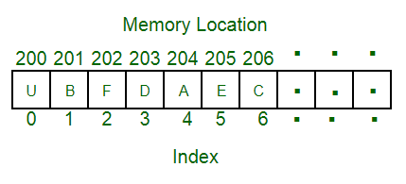
Computer Programming
Programming is a way to “instruct the computer to perform various tasks”.
Algorithm + Data Structure = Program
written by Niklaus Wirth in 1976 book covering some of the fundamental topics of
computer programming
Note : A data structure is a particular way of organizing data in a computer so that it can be used effectively.
For example, we can store a list of items having the same data-type using the array data structure.
GLA UNIVERSITY

Slide 12
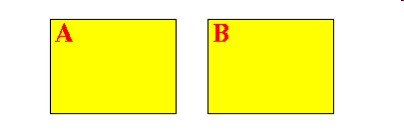
A real life algorithm
Here is a famous algorithm that you can try out:
Take 2 pieces of paper and write on one piece "A" and on the other piece "B":
Write a positive integer on each piece of paper.
GLA UNIVERSITY

Slide 13
A real life algorithm (cont.)
Euclid's Algorithm:
As long as one of the number is not zero (0) do
{
if ( number on A ≥ number on B )
replace the number on A by the value (A - B)
otherwise
replace the number on B by the value (B - A)
}
The Greatest Common Divisor (GCD) of the numbers A and B is the non-zero number on one of the papers
GLA UNIVERSITY

Slide 14
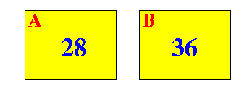
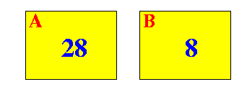
A real life algorithm (cont.)
Example of the Euclid Algorithm:
We start with the following 2 number:
Since number on A < number on B, we replace the number on B (= 36) by the value (B − A) = 8:
GLA UNIVERSITY

Slide 15
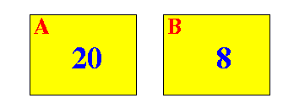
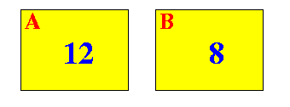
A real life algorithm (cont.)
Now number on A ≥ number on B, so we replace the number on A (= 28) by the value (A − B) = 20:
Again, number on A ≥ number on B, so we replace the number on A (= 20) by the value (A − B) = 12:
GLA UNIVERSITY

Slide 16
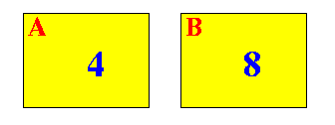
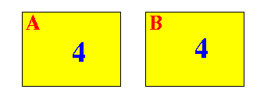
A real life algorithm (cont.)
Yet again, number on A ≥ number on B, so we replace the number on A (= 12) by the value (A − B) = 4:
This time, number on B > number on A, so we replace the number on B (= 8) by the value (B − A) = 4:
GLA UNIVERSITY

Slide 17
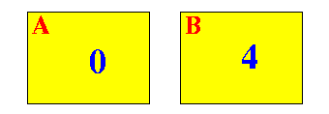
A real life algorithm (cont.)
Now, number on A ≥ number on B, so we replace the number on A (= 4) by the value (B − A) = 0:
One of the number on the papers is now zero
According to the Euclid's Algorithm, the other number (= 4) is equal to the GCD of (28, 36)
GLA UNIVERSITY

